Slide 1
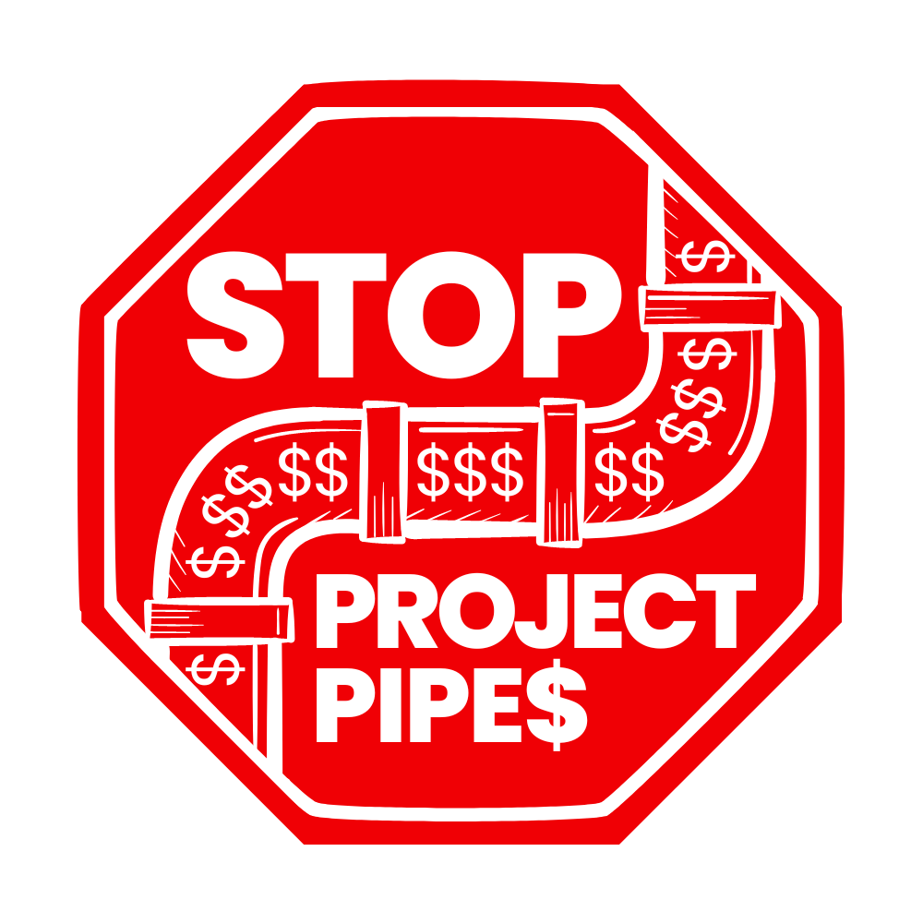
Naomi Cohen-Shields
DC Campaigns Manager, CCAN

Slide 2
PROJECTpipes: the basics
Gas pipelines in DC are really old, with increasing methane leaks and gas explosions
PROJECTpipes is a 40-year accelerated pipeline replacement program launched in 2014, spanning until at least 2054
Notes:
A - The gas distribution system in DC is among the oldest in the country, with 1,200 miles of pipes, much of it aging and leak-prone cast iron. PROJECTpipes aims to replace the old pipe with plastic, which can have a lifespan of over 70 years—intending to keep us locked into using climate-harming gaseous fuels for decades past our net zero target year of 2045.

Slide 3
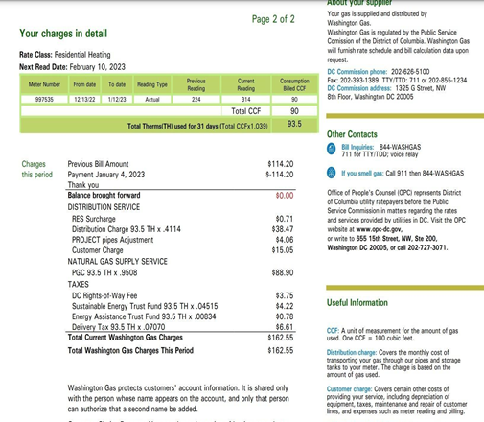
Ratepayers pay for PROJECTpipes.
Notes:
A - You can see the separate surcharge for PROJECTpipes right there on the gas bill.

Slide 4
PROJECTpipes phases
PROJECTpipes 1:
2014-2019
Cost $110 million
Budget extended to $141.25 million
PROJECTpipes 2:
2021-2023
Cost $150 million
PROJECTpipes 3:
2024-2028
REQUESTING $671.8 MILLION
TOTAL COST OF PROJECTpipes: ~$4.5 billion, or $27,000 per ratepayer.
Washington Gas wants a new decision on Project Pipes as soon as possible.
Notes:
N

Slide 5
What’s wrong with PROJECTpipes?
Notes:
A [section: ~6min]

Slide 6
Blocks DC’s Climate Goals
DC has a climate pledge of net carbon neutrality by 2045
WGL is investing huge amounts of ratepayer money to replace miles of pipeline in DC, forcing re-investment in gas infrastructure
A better solution is to repair the worst pipes, knowing that DC will electrify in the coming years.
Putting billions into gas infrastructure directly contradicts DC’s carbon neutrality goals.
Notes:
A

Slide 7
2. Energy Equity
WGL is forcing ratepayers to bear the burden of Project Pipes
As DC electrifies, wealthier households will be the first to move off of the gas network
This means that the remaining ratepayers will be lower-income residents, who will be forced to bear disproportionate costs of Project Pipes
Ratepayer burden affects low-income households the most.

Slide 8
3. Public Health
Burning methane releases toxic substances like nitrogen dioxide that cause harmful indoor air quality.
Burning methane is dangerous for households because it is linked to respiratory, cardiovascular, and other illnesses.
Gas stoves can leak methane even when they are turned off.
Burning natural gas is a household danger.
Notes:
A - Having your gas stove turned on is like running your car’s engine inside the house.
It’s estimated that 75% of methane escapes while the stove is turned off.

Slide 9
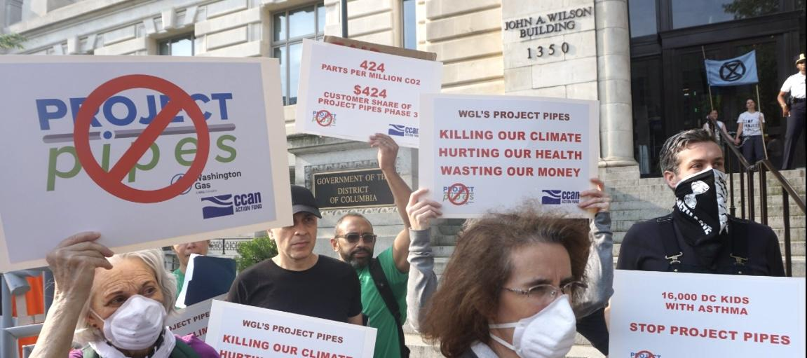
Our Campaign

Slide 10
Three-pronged approach
PUBLIC AWARENESS
INVOLVING THE DC COUNCIL
OUTREACH & COALITION BUILDING

Slide 11
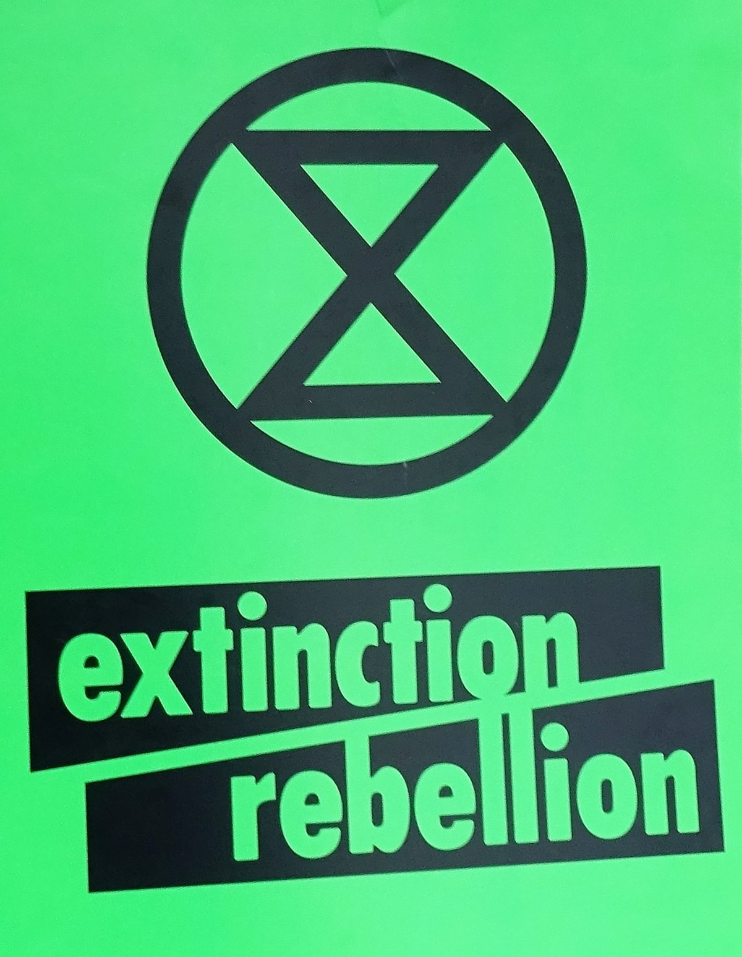
Who we’re working with
Notes:
N - How are we doing this? We have working groups for each of these approaches, with representatives from across our coalition. We meet weekly, and are quickly building momentum. We value coordination, transparency, and inclusion in building our coalition, and welcome more participation and input in each area. These are some of our partners…
Also partners such as OPC, AOBA in the legal proceedings at PSC. And building our coalition is ongoing!

Slide 12
Please pass a resolution against PROJECTpipes
Notes:
We have a sample resolution that we’d be happy to provide you with as a template.

Slide 13
Questions?
Contact info:
Naomi Cohen-Shields
DC Campaigns Manager naomi@chesapeakeclimate.org
TAKE ACTION NOW!
Notes:
N [remaining time] - So, we’d like to end this call by giving you all an opportunity to take your first action on PROJECTpipes with us right now. On the right is a QR code that if you scan, it’ll take you to our petition against projectpipes, and we’ll also put the link in the chat. Signing this petition is a great way to demonstrate public dissent against projectpipes. https://act.ccanactionfund.org/page/54246/petition/1?locale=en-US

Slide 14
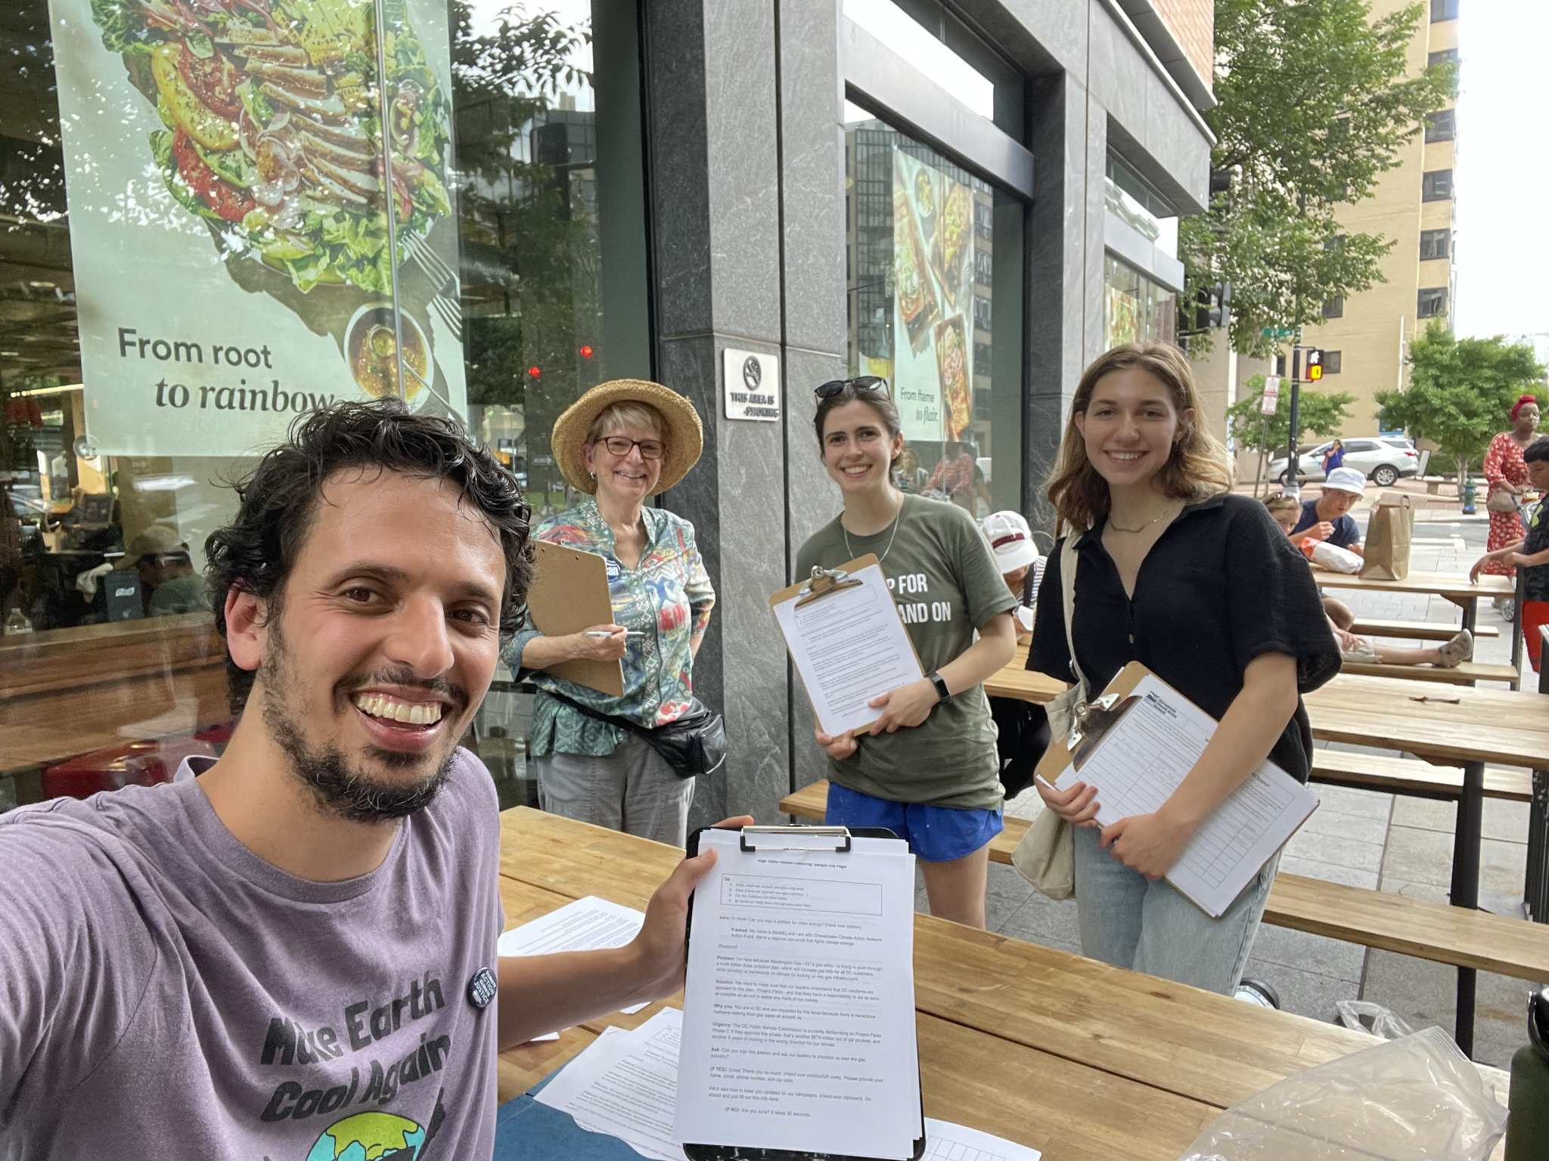
How can you help?
Sign up to volunteer with us through:
Petition gathering
Tabling at farmer’s markets
Join a working group!
Spreading the message to your neighbors, friends, and affiliated organizations
Joining upcoming rallies and events
Part of a DC organization? Become a coalition partner!
Got other ideas for the campaign or how you want to be involved? We’d love to hear them!
Notes:
N

Slide 15
WGL is Greenwashing PROJECTpipes
WGL claims that:
“PROJECTpipes work has…reduced greenhouse gases released from its distribution system.”
The truth is that:
PROJECTpipes 3 will further lock DC into a gas pipeline system, resulting in more greenhouse gas emissions in the future
“The program will enhance the safety and reliability of DC’s pipeline system”
Methane gas is dangerous for consumers and hazardous gas leaks in DC’s system have increased by 15% in the last 6 years

Slide 16
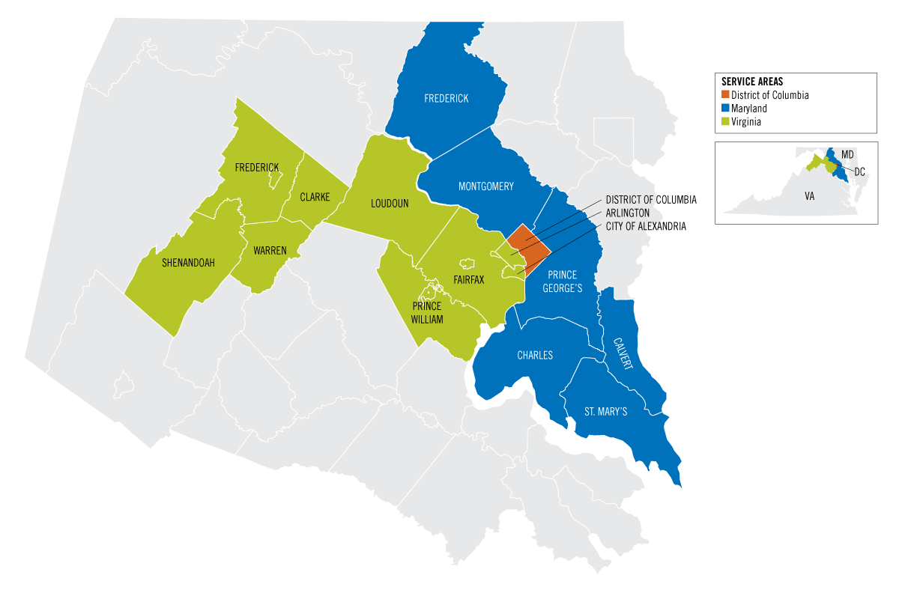
Washington Gas
WGL is the monopoly gas utility in DC, serving 165,000 households within the District of Columbia.
Notes:
This map shows the service area for Washington in the DMV. (Why are we showing this?) The company is actually owned by Canadian gas infrastructure giant AltaGas, Ltd., which has been trying to sell WGL for over a year.

Slide 17
Three-pronged approach
PUBLIC AWARENESS
INVOLVING THE DC COUNCIL
OUTREACH & COALITION BUILDING

Slide 18
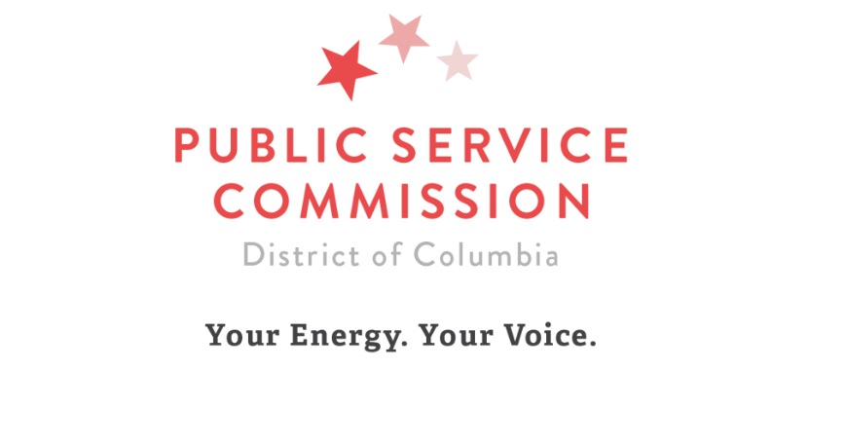
The DC Public Service Commission
Oversees/regulates the electric, gas and telephone utilities
Receives funding from these same utilities.
The PSC functions somewhat like a court and is separate from other parts of DC government.
Some PSC staff are former WGL employees, and their impartiality is questionable.
Notes:
The PSC is a quasi-judicial body (could add more info)

Slide 19
DC Council
The Committee on Business and Economic Development is responsible for overseeing the PSC.
The 2018 Clean Energy Act included a climate mandate for the PSC
The Council has the power to push the PSC towards more climate-focused actions

